Slide 1
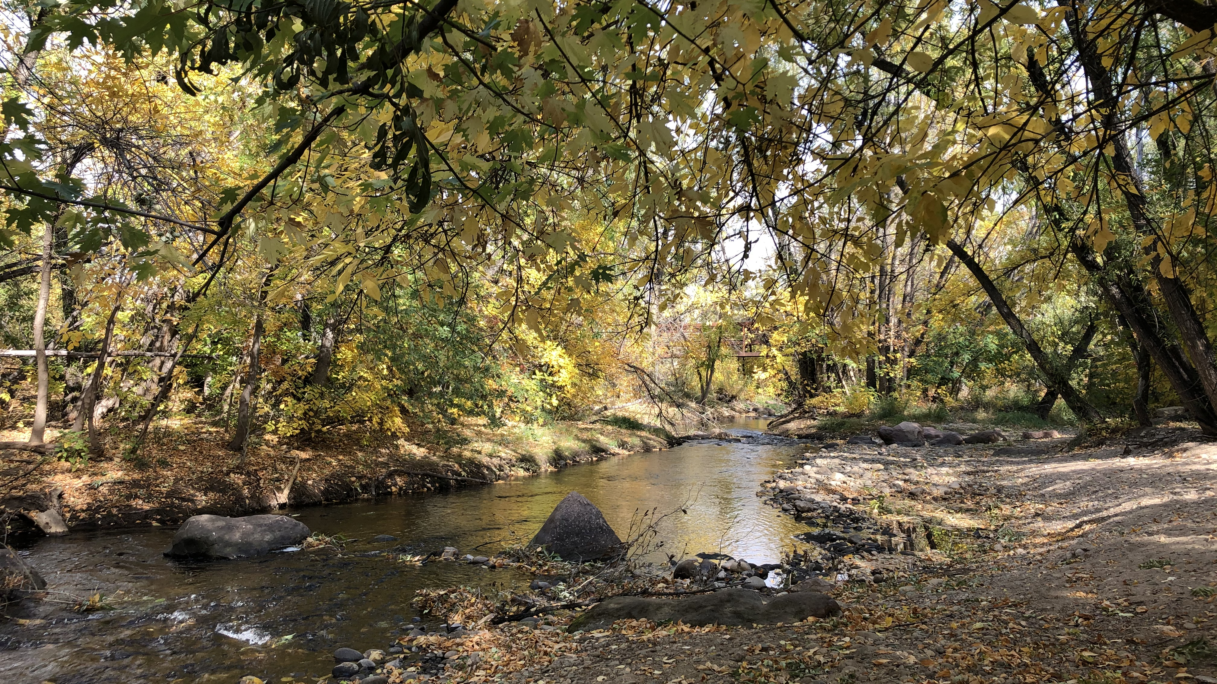

Grouping and aggregating
Elsa Culler
Analysing Boulder Creek streamflow data
Link to presentation: https://tinyurl.com/kmx86svn
Link to all lesson materials: https://github.com/eculler/grouping-and-aggregating/

Slide 2
Learning goals: at the end of this lesson, you should be able to…
analyze time series’ of streamflow data from multiple locations
identify when data analysis will require grouping and aggregating
group and aggregate data in Python using the pandas library

Slide 3
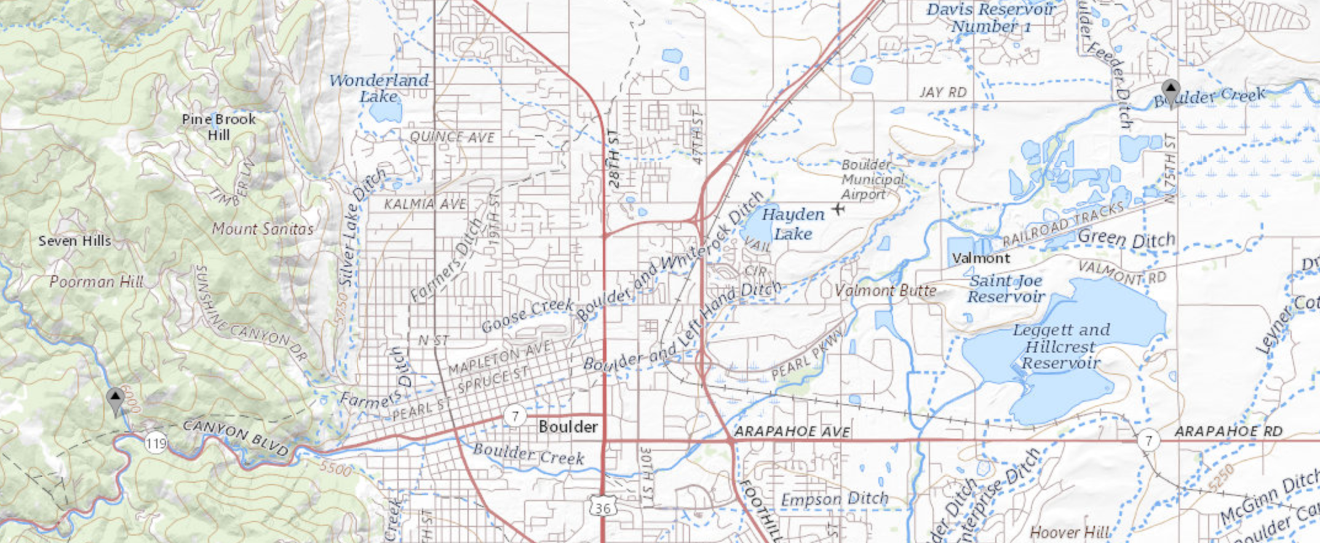
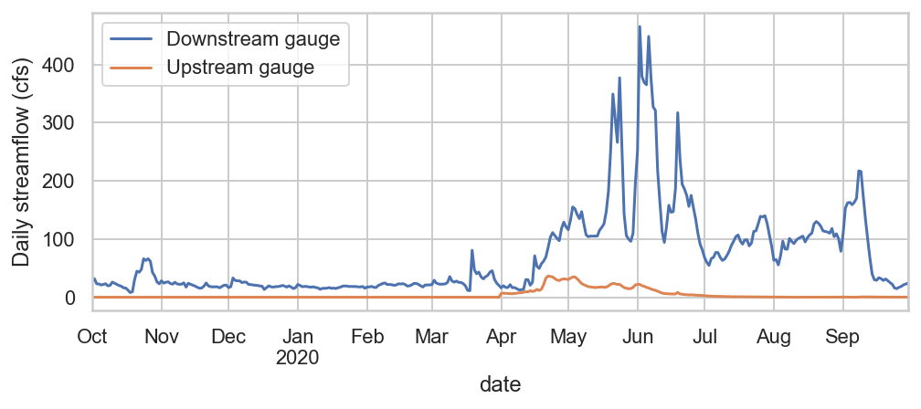
Example data: Ten years of streamflow data from two gauges on Boulder Creek
Streamflow can be very different at an upstream location compared to a downstream location on the same stream
Downstream
gauge
Upstream
gauge
One year of data:

Slide 4
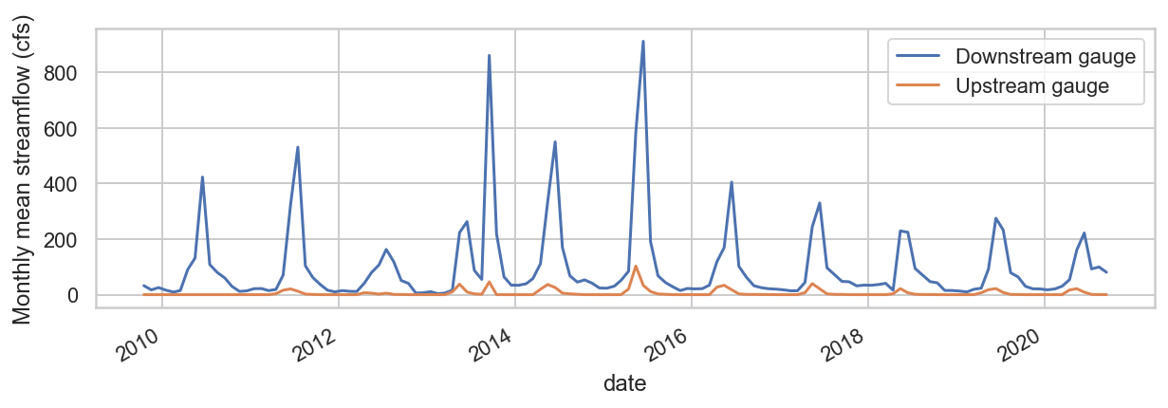
There are many smaller streams that flow into the downstream location. How much of the total streamflow at the downstream gauge comes from the upstream gauge’s branch, on average?
Notes:
Put a guess in the chat

Slide 5
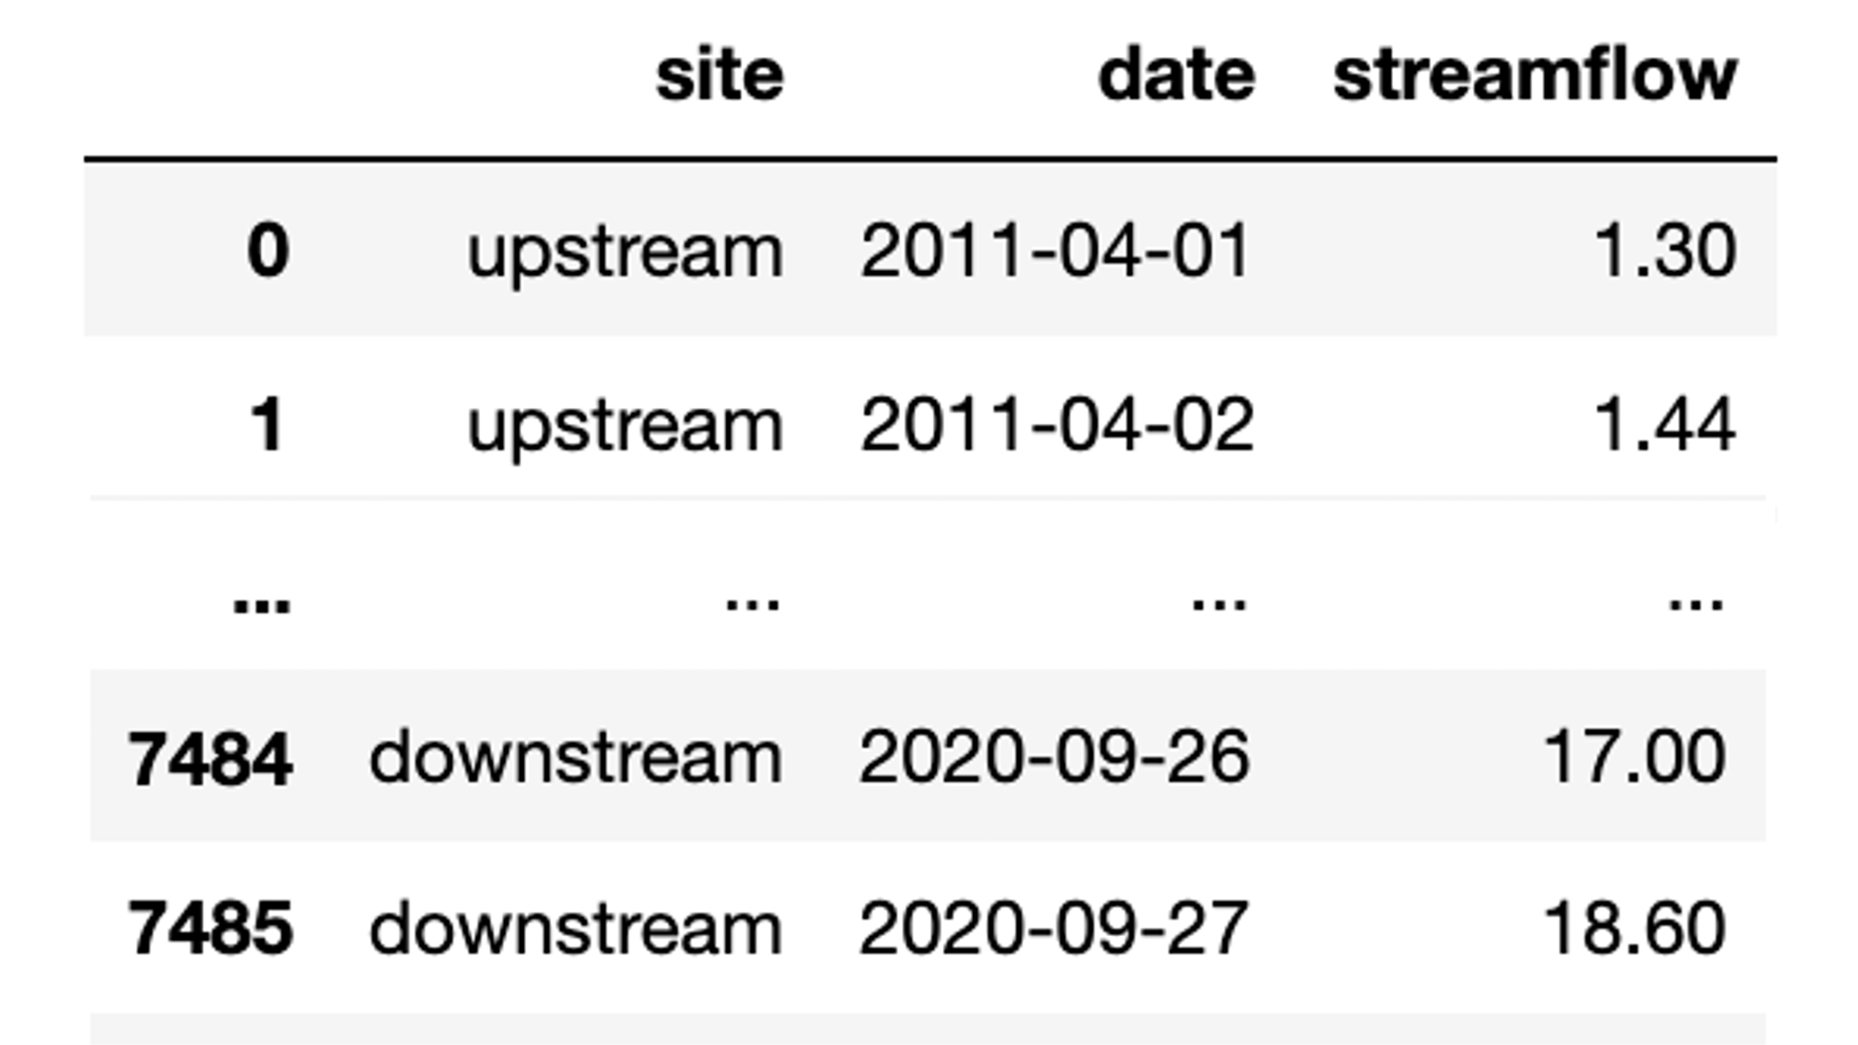
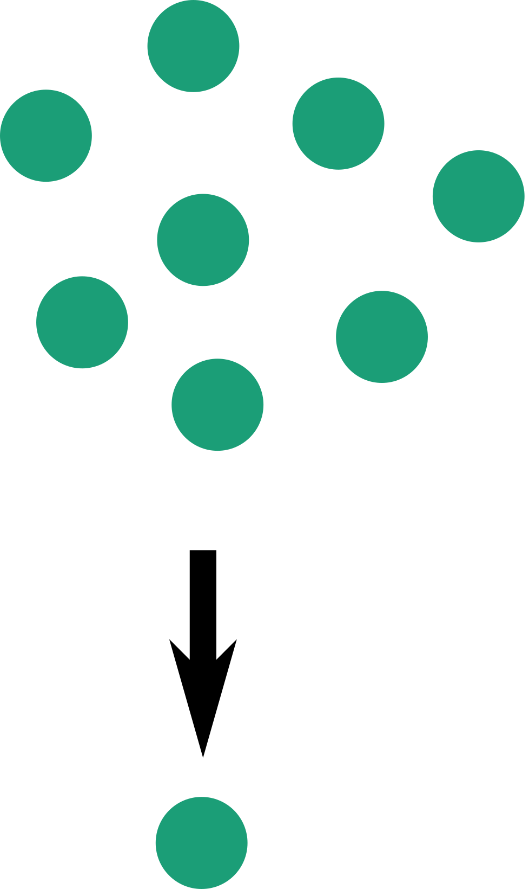
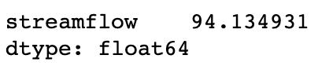
An aggregating function takes many data points and returns a single number that describes them all.
Examples include mean, minimum, maximum, median, count
dataframe
dataframe.agg(‘mean’)

Slide 6
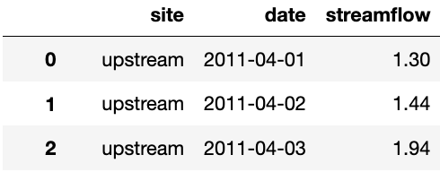
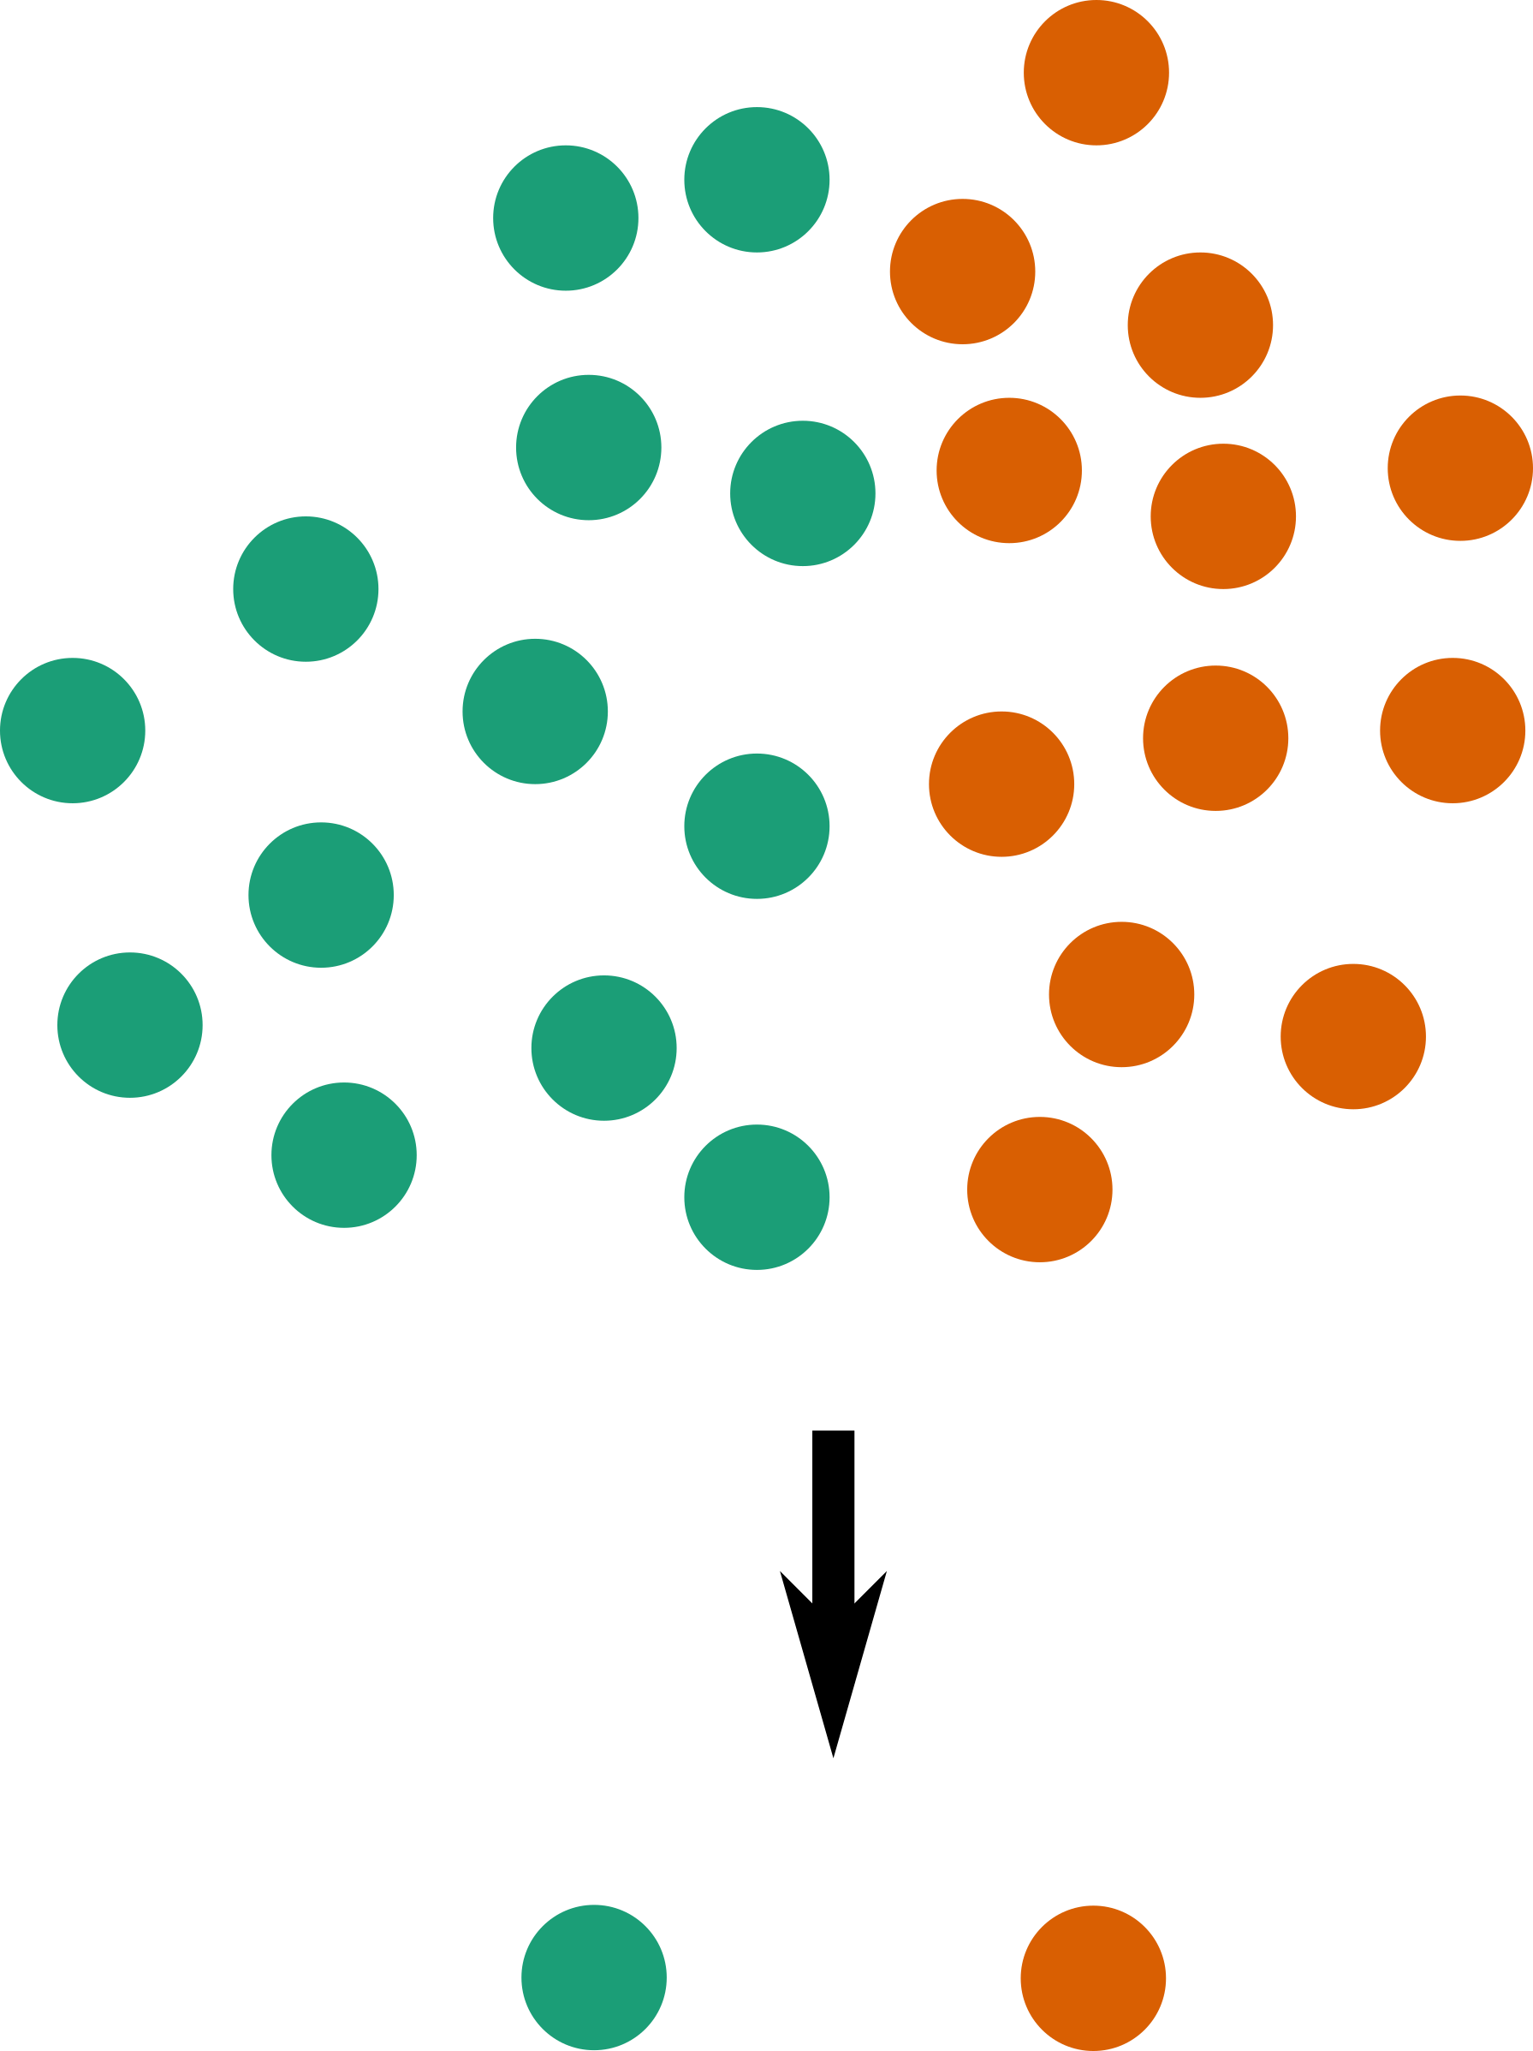
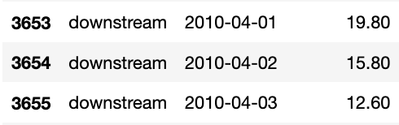
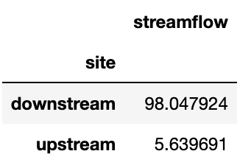
Aggregating functions can be used to compare groups of data with different properties
For example, data could be grouped by date, location, cluster, or event
dataframe.groupby(‘site’)
dataframe.groupby(‘site’
).agg(‘mean’)
Percentage of downstream streamflow from the upstream gauge: 6%
Notes:
Can you think of any other variables to group by when aggregating the Boulder streamflow data? What would another way of grouping tell us about streamflow at these locations?

Slide 7
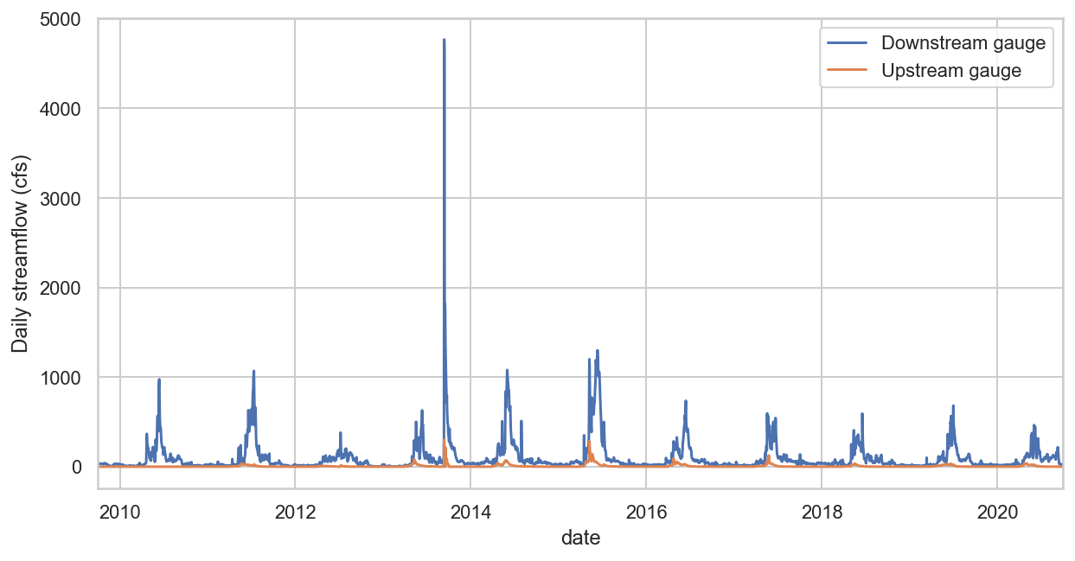
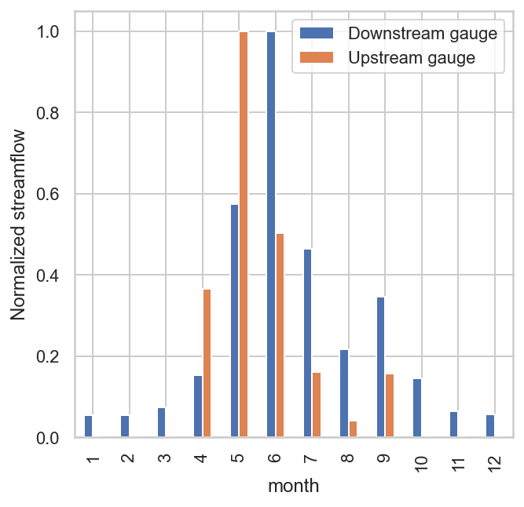
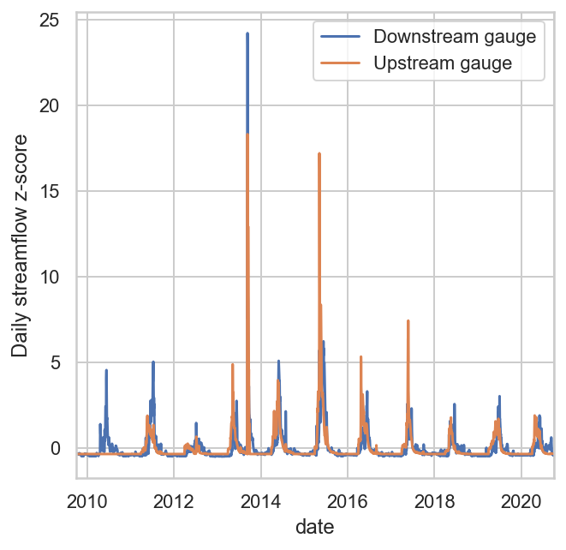
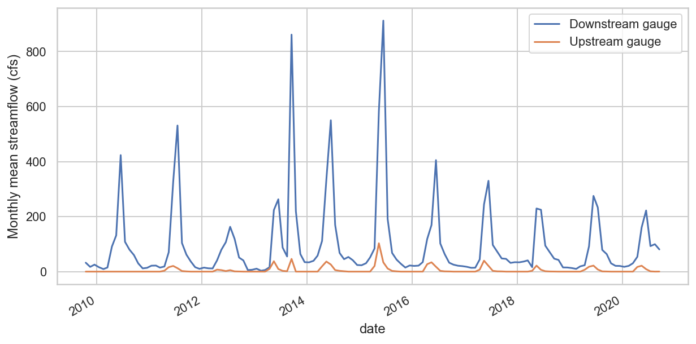
Grouping and aggregating is needed for a variety of different methods of streamflow analysis:
Let’s try it! Practice these three analysis techniques at the following link:
https://tinyurl.com/544j5c4a
Monthly, seasonal, or annual aggregation
Comparing climatology
Comparing variability

Slide 8
Function reference: Grouping and aggregating using Python and pandas
pandas.DataFrame.groupby(by)
Set the variable(s) you want to use to group the data.
Does not change the data
pandas.DataFrame.agg(func)
Applies func (a function or list of functions) to return one row for each group
Special aggregating functions like mean(), max(), and min() are also available

